Slide 1
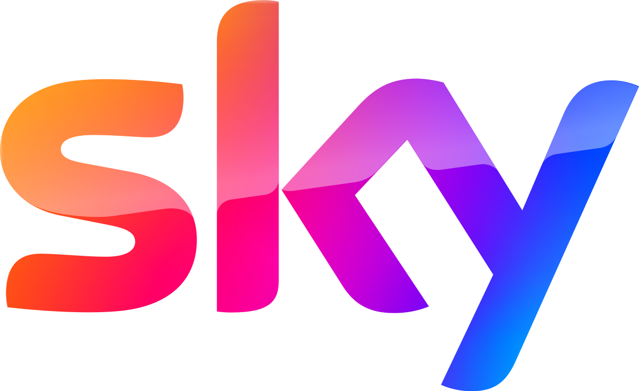
Building Vertex AI pipelines
Raj Mudigonda
ML Engineer (SKY Anti-Piracy)

Slide 2
Agenda
Challenges with the Basic ML Approach
Why Vertex AI?
Other Options for Experiment Tracking
Why Kubeflow?
Kubeflow with Vertex AI
What is Docker? Do We Really Need Docker?
Sample Structure of a Kubeflow Pipeline
Demo: Running a Kubeflow Pipeline Using Vertex AI
MLOps Best Practices
Tracking Experiments, Metrics, Pipelines YAML, CI/CD

Slide 3
Basic Machine Learning Steps
Data Collection
Data Preprocessing
Model Training
Model Evaluation
Model Deployment
Model Monitoring
Data Collection: Gather data from various sources.
Data Preprocessing: Clean and prepare data for analysis.
Model Training: Train machine learning models on preprocessed data.
Model Evaluation: Evaluate model performance on test data.
Model Deployment: Deploy models into production environments.
Model Monitoring: Monitor model performance and update as needed.

Slide 4
Challenges with the Basic ML Approach
Manual Processes: Many steps are manual, leading to inconsistencies and errors.
Reproducibility: Hard to reproduce results without automated logging and tracking.
Scaling: Scaling manually managed models is challenging and resource-intensive.
Deployment & Monitoring: Lack of standardized deployment pipelines and monitoring makes maintaining models in production difficult.

Slide 5
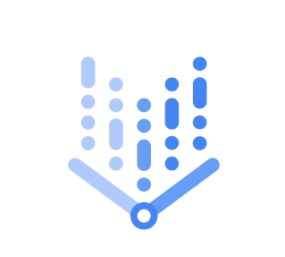
Why Vertex AI?
Integrated Platform: Offers a comprehensive suite of tools for the entire ML lifecycle.
Managed Services: Reduces the need to manage infrastructure.
Scalability: Easily scales with your workload.
Integration: Works seamlessly with other Google Cloud products like BigQuery, Dataflow, etc.
VERTEX AI
Vertex AI Workbench
Vertex AI Training
Vertex AI Prediction
Vertex AI Pipelines
Vertex AI Feature Store
Vertex AI Model Monitoring
Vertex AI Model Experiments
Vertex AI Model Registry

Slide 6
Other Options for Experiment Tracking
Feature | MLflow | Neptune | Vertex AI Pipelines (Kubeflow)
Setup and Maintenance | Requires setup and maintenance | Requires subscription | Managed by Google Cloud
Integration with GCP | Integrates via APIs and SDKs | Integrates via APIs and SDKs | Native integration with GCP
Experiment Tracking | Yes | Yes | Yes
Model Registry | Yes | Yes | Yes
User Interface | Basic dashboard | Rich, user-friendly | Integrated with Vertex AI UI
Scalability | Scalable with custom setup | Scalable with subscription | Highly scalable with GCP
Reproducibility | Good | Good | Excellent with managed services
Flexibility | High | High | High within GCP ecosystem
Cost | Free with self-hosting | Subscription-based | Pay-as-you-go with GCP

Slide 7
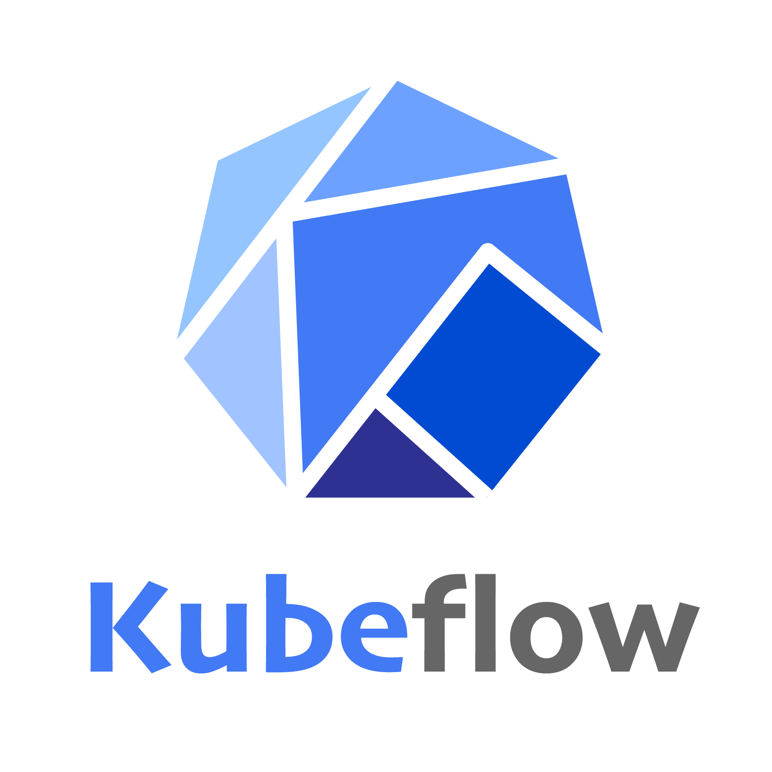
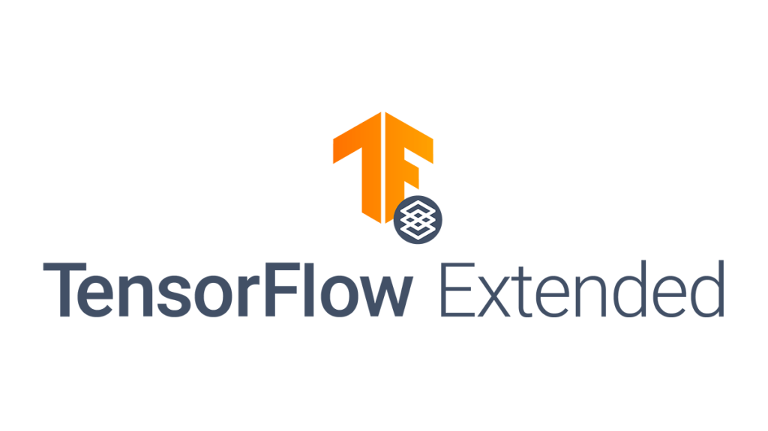
Vertex AI Pipelines
A serverless product to run kubeflow or TFX pipelines
TensorFlow Extended and Kubeflow Pipelines are SDKs to build production ML pipelines.
Kubeflow is a open source machine learning toolkit.
Kubeflow runs on top of Kubernetes.
Vertex AI Pipeline is a product to run pipelines serverless.
Reduce the effort required to maintain and manage a Kubernetes cluster.

Slide 8

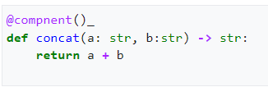
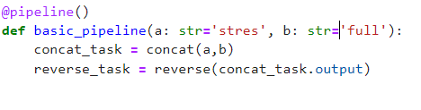
Kubeflow Pipeline
Required Modules
Components
One Component has 1 specific task
It contains all code to perform the task
It produces some kind of output
Pipeline
The pipeline connects the components and defines pipeline parameters

Slide 9
Vertex AI Metadata
Artifacts
Used to pass data between components or to visualize and store information.
Artifacts are used for larger or complex data.
Most artifacts are nothing more than a simple reference, a file path.
Types: Dataset, Model, Metrics and Visualization
Model Lineage
Pipeline runs produce metadata and artifacts.
Necessary for the reproducibility of our pipeline.
Process is called model lineage or lineage tracking.
Stored in Vertex AI Metadata.

Slide 10
Components Types
Function Based Component | Container based component
The most simple one Just write a Python function and add a decorator. | Anything that can be packed into a Docker Container can run as a component. Flexibility to run a component in any programming language. Can be uploaded to Google Container / Artifact Registry.

Slide 11
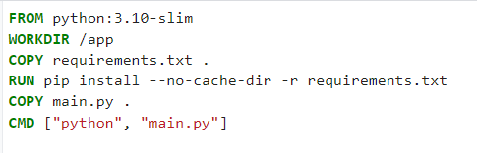

Usage of Docker
requirements.txt

Slide 12
Kubeflow with Vertex AI
End-to-End Pipelines: Supports the entire ML workflow from data preparation to deployment.
Scalability: Runs on Kubernetes, making it inherently scalable.
Flexibility: Supports multiple frameworks and languages.
Community Support: Strong community and continuous updates.
Enhanced Capabilities: Combines the best of both worlds – managed services with flexible, open-source tools.
Simplified Management: Vertex AI manages the infrastructure, letting you focus on building models.
Improved Tracking: Kubeflow’s experiment tracking integrated with Vertex AI's managed services offers a robust tracking solution.

Slide 13
Demo

Slide 14


Slide 15
Appendix

Slide 16
TFX vs Kubeflow pipelines
Feature | TFX | Kubeflow Pipelines
Framework Support | Primarily TensorFlow | Framework-agnostic (TensorFlow, PyTorch, etc.)
Orchestration | Apache Beam, Airflow | Kubernetes
Pipeline Components | Pre-built TensorFlow-centric components | Custom and pre-built components
Integration with GCP | Strong (e.g., Dataflow, AI Platform) | Strong (runs on GKE, integrates with GCP services)
Scalability | High (using GCP services) | High (leveraging Kubernetes)
Flexibility | Less flexible (TensorFlow focus) | More flexible (supports multiple frameworks)
Model Serving | TensorFlow Serving, TF Lite | KFServing, TensorFlow Serving, custom options

Slide 17
Local Kubeflow Test
To make the kfp pipeline work locally we can install kfp in virtualenv and install.
Then just compile the kfp pipeline. If there is any syntax error that will be resulted here.
Feature store
Not required as of now for storing features as ours is batch prediction.
Can use feature store if you require low latency.
Cost estimate of vertexai

